Slide 1
Analitika Data
Ivonne Martin

Slide 2
Syllabus
Introduction
Statistical Learning
Linear Regression
Classification
Resampling Methods
(Linear Model Selection and Regularization)

Slide 3
Komponen Penilaian
Tugas : Quiz + Homework
UTS
UAS

Slide 4
Computational Skills
Please bring laptop with R/ RStudio installed.
Or using Posit with R

Slide 5
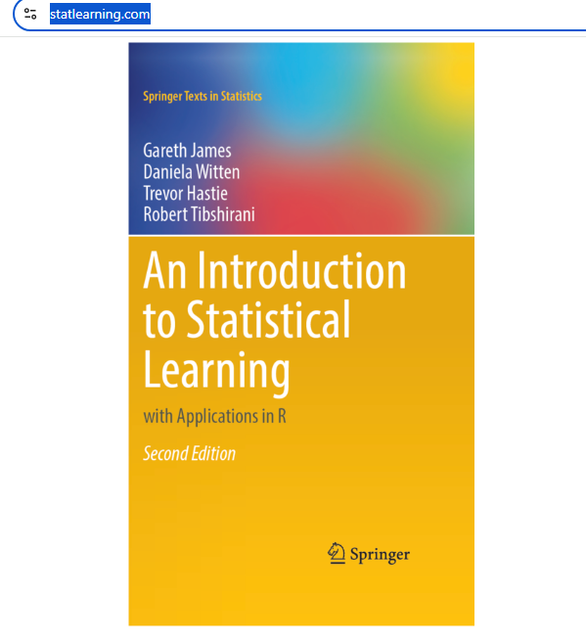
Reference
Introduction to Statistical Learning: with Application in R.
Available at www.statlearning.com

Slide 7
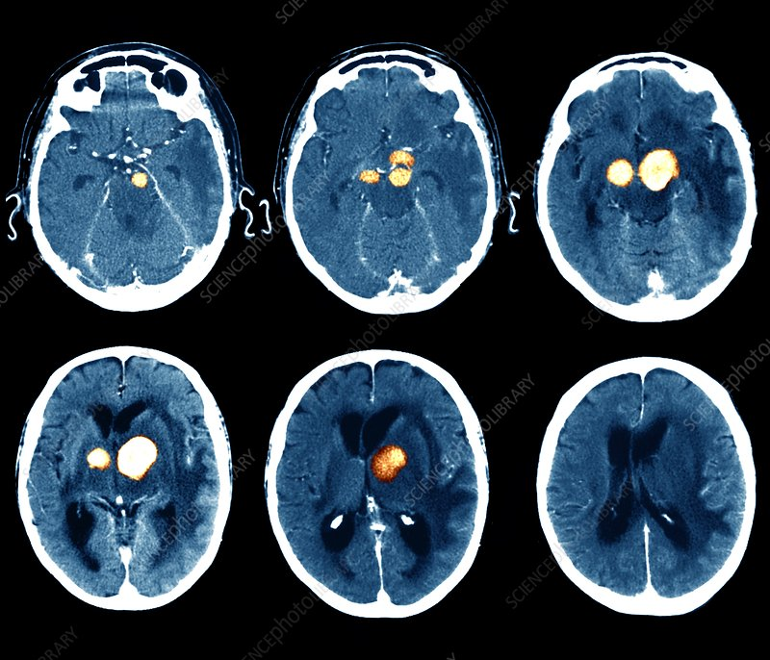
Another example: Brain Tumor CT-scan
Predict the tumor stage
Predict the survival

Slide 8
Statistical learning
Definition: vast tools to understand data.
Many elements of statistics were used (regressions, classifications).
What makes statistical learning different from its underlying concepts (regression, classification), if any?
Supervised and Unsupervised learning.

Slide 9
Supervised or unsupervised?
We collect a set of data on the top 500 firms in the US. For each firm we record profit, number of employees, industry and the CEO salary. We are interested in understanding which factors affect CEO salary.

Slide 10
Supervised or unsupervised?
We are considering launching a new product and wish to know whether it will be a success or a failure. We collect data on 20 similar products that were previously launched. For each product we have recorded whether it was a success or failure, price charged for the product, marketing budget, competition price, and ten other variables.

Slide 11
Supervised or unsupervised?
We are interested in predicting the % change in the USD/Euro exchange rate in relation to the weekly changes in the world stock markets. Hence we collect weekly data for all of 2012. For each week we record the % change in the USD/Euro, the % change in the US market, the % change in the British market, and the % change in the German market

Slide 12
Real life application
“Describe three real-life applications in which regression might
be useful. Describe the response, as well as the predictors. Is the
goal of each application inference or prediction? Explain your
answer.”

Slide 13
Real life application
“Describe three real-life applications in which cluster analysis might be useful.”

